Slide 1

Unit-2 Data Pre-Processing
Data Mining (DM)
2101CS521
Prof. Jayesh D. vagadiya
Computer Engineering Department
jayesh.vagadiya@darshan.ac.in
9537133260

Slide 2

Looping
Topics to be covered
Why to pre-process data?
Data cleaning
Data Integration
Data Transformation
Data Reduction
Data Discretization

Slide 3
Why to pre-process data?
Data pre-processing is a data mining technique that involves transforming raw data (real world data) into an understandable format.
Real-world data is often incomplete, inconsistent, lacking in certain behaviors or trends and likely to contain many errors.
Incomplete: Missing attribute values, lack of certain attributes of interest, or containing only aggregate data.
E.g. Occupation = “ ”
Noisy: Containing errors or outliers.
E.g. Salary = “abcxy”
Inconsistent: Containing similarity in codes or names.
E.g. “Gujarat” & “Gujrat” (Common mistakes like spelling, grammar, articles)

Slide 4



Why to pre-process data? (Cont..)
It looks like Garbage In Garbage Out (GIGO).
Quality decisions must be based on quality data.
Duplicate or missing data may cause incorrect or even misleading statistics.
Data preprocessing prepares raw data for further processing.
Data preparation, cleaning and transformation are the majority task (90%) in data mining.

Slide 5

Data Cleaning
Fill in missing values
Identify outliers and smooth out noisy data
Correct inconsistent data
Resolve redundancy caused by data integration

Slide 6
1) Fill in missing values
Data Cleaning
Ignore the tuple (record/row):
Usually done when class label is missing.
This means removing the entire row from the dataset if any of its values are missing.
This approach can be useful when the number of missing values is relatively small, and removing a few tuples does not significantly impact the overall data analysis.
Fill missing value manually:
In general, this approach is time consuming and may not be feasible given a large data set with many missing values.
Use a global constant to fill in the missing value
Replace all missing attribute values by the same constant such as a label like “Unknown” or −∞ .
Use a measure of central tendency for the attribute (e.g., the mean or median) to fill in the missing value :
For normal (symmetric) data distributions, the mean can be used, while skewed data distribution should employ the median

Slide 7
1) Fill in missing values
Data Cleaning
Use the attribute mean or median for all samples belonging to the same class as the given tuple:
To replace the mean or median in the same class, you would typically calculate the mean or median for all samples within that class and use the resulting value as the replacement.
Use the most probable value to fill in the missing value:
This may be determined with regression, inference-based tools using a Bayesian formalism, or decision tree induction

Slide 8
2) Identify outliers and smooth out noisy data
Data Cleaning
There are three data smoothing techniques as follows..
Binning :
Binning methods smooth a sorted data value by consulting its “neighborhood” that is, the values around it.
Regression :
It conforms data values to a function.
Linear regression involves finding the “best” line to fit two attributes (or variables) so that one attribute can be used to predict the other.
Outlier analysis :
Outliers may be detected by clustering for example, where similar values are organized into groups or “clusters”.
In this, values that fall outside of the set of clusters may be considered as outliers.

Slide 9

1. Binning Method
Data Cleaning
Binning method is a top-down splitting technique based on a specified number of bins.
In this method the data is first sorted and then the sorted values are distributed into a number of buckets or bins.
For example, attribute values can be discretized (separated) by applying equal-width or equal-frequency binning, and then replacing each value by the bin mean, median or boundaries.
It can be applied recursively to the resulting partitions to generate concept hierarchies.
It used to minimize the effects of small observation errors.
Identify outliers and smooth out noisy data

Slide 10
1. Binning Method Cont..
Data Cleaning
There are basically two types of binning approaches..
Equal width (or distance) binning :
The simplest binning approach is to partition the range of the variable into k equal-width intervals.
The interval width is simply the range [Min, Max] of the variable divided by N,
Width = Max – Min / N (Number of Bins)
Example
Data: 5,10,11,13,15, 35, 50, 55, 72, 92, 204, 215
As per above formula we have Max=215, Min=5, Number of Bins=3, so 215-5 = 210, 210/3 = 70
70+5=75 (from 5 to 75) = Bin 1: 5,10,11,13,15, 35, 50, 55, 72
70+75=145 (from 75 to 145) = Bin 2: 92
70+145=215 (from 145 to 215) = Bin 3: 204, 215
Equal depth (or frequency) binning :
In equal-frequency binning we divide the range [Max, Min] of the variable into intervals that contain (approximately) equal number of points; equal frequency may not be possible due to repeated values.
Identify outliers and smooth out noisy data

Slide 11
1. Binning Method Cont..
Data Cleaning
Bin Operations
Smoothing by bin means
In smoothing by bin means, each value in a bin is replaced by the mean value of the bin.
Smoothing by bin median
In this method each bin value is replaced by its bin median value.
Smoothing by bin boundary
In smoothing by bin boundaries, the minimum and maximum values in a given bin are identified as the bin boundaries.
Each bin value is then replaced by the closest boundary value.
Identify outliers and smooth out noisy data

Slide 12
Binning Method Example – {Bin Means}
Data Cleaning
Given data: 4, 8, 9, 15, 21, 21, 24, 25, 26, 28, 29, 34
Step: 1
Partition into equal-depth [n=3]:
Bin 1: 4, 8, 9, 15
Bin 2: 21, 21, 24, 25
Bin 3: 26, 28, 29, 34
Step: 2
Smoothing by bin means:
Bin 1: 9, 9, 9, 9
Bin 2: 23, 23, 23, 23
Bin 3: 29, 29, 29, 29
Bin Means
(4 + 8 + 9 + 15)/4 = 9
(21 + 21 + 24 + 25)/4 = 23
(26 + 28 + 29 + 34)/4 = 29
Identify outliers and smooth out noisy data

Slide 13
Binning Method Example – {Bin Boundaries}
Data Cleaning
Given data: 4, 8, 9, 15, 21, 21, 24, 25, 26, 28, 29, 34
Step: 1
Partition into equal-depth [n=4]:
Bin 1: 4, 8, 9, 15
Bin 2: 21, 21, 24, 25
Bin 3: 26, 28, 29, 34
Step: 2
Smoothing by bin boundaries:
Bin 1: 4, 4, 4, 15
Bin 2: 21, 21, 25, 25
Bin 3: 26, 26, 26, 34
Identify outliers and smooth out noisy data

Slide 14
2. Regression
Data Cleaning
Data smoothing can also be done by regression, a technique that conforms data values to a function.
Regression analysis is a way to find trends in data & it is also called as mathematically describes the relationship between independent variables and the dependent variable.
It can be divided into two categories..
Linear regression :
It involves finding the “best” line to fit two attributes (or variables) so that one attribute can be used to predict the other.
In this, analysis on a single x variable for each dependent “y” variable. For example: (x₁, Y₁).
Multiple linear regression :
An extension of linear regression, where more than two attributes are involved and the data are fit to a multidimensional surface.
It uses multiple “x” variables for each independent variable: (x1)₁, (x2)₁, (x3)₁, Y₁).
Identify outliers and smooth out noisy data

Slide 15
3. Clustering
Data Cleaning
Cluster analysis or clustering is the task of grouping a set of objects in such a way that objects in the same group (called a cluster) are more similar (in some sense) to each other than to those in other groups (clusters).
Cluster analysis as such is not an automatic task, but an iterative process of knowledge discovery or interactive multi-objective optimization that involves trial and failure.
It is often necessary to modify data preprocessing and model parameters until the result achieves the desired properties.
Cluster center
Outliers
Identify outliers and smooth out noisy data

Slide 16
Correct Inconsistent Data
Data Cleaning
With larger datasets, it can be difficult to find all of the inconsistencies.
It contains similarity in codes or names.
We can manually solve common mistakes like spelling, grammar, articles or use other tools for it.

Slide 17
Resolve redundancy caused by data integration
Data Cleaning
Data redundancy occurs in database systems which have a field that is repeated in two or more tables.
When customer data is duplicated and attached with each product bought, then redundancy of data is known as inconsistency.
So, the entity "customer" might appear with different values.
Database normalization prevents redundancy and makes the best possible usage of storage.
The proper use of foreign keys can minimize data redundancy and reduce the chance of destructive anomalies appearing.

Slide 18

Data Integration
Data Integration
Combines data from multiple sources into a coherent store.
Careful integration can help reduce and avoid redundancies and inconsistencies in the resulting data set.
Schema integration: e.g., A.cust-id ≡ B.cust#

Slide 19
Entity Identification Problem
Data Integration
How can real-world entities from different data sources be matched?
This is referred to as the entity identification problem.
Example:
The customer id in one database and cust number in another refer to the same attribute?
When matching attributes from one database to another during integration, special attention must be paid to the structure of the data.
This is to ensure that any attribute functional dependencies and referential constraints in the source system match those in the target system.
Example:
Imagine there are two separate systems: System A and System B. In System A, discounts are applied to the entire order, whereas in System B, discounts are applied to each individual line item within the order.
Items in the target system may end up being improperly discounted.

Slide 20
Redundancy and Correlation Analysis
Data Integration
Redundancy is another important issue in data integration. An attribute (such as annual revenue, for instance) may be redundant if it can be “derived” from another attribute or set of attributes.
This redundancy can consume additional storage space, introduce inconsistencies, and complicate data management processes.
Example:
if annual revenue can be obtained by summing up monthly revenue values, storing both the individual monthly revenue and the derived annual revenue would result in redundant data.
Some redundancies can be detected by correlation analysis.
We can evaluate the correlation between two attributes, A and B, by computing the correlation coefficient.

Slide 21
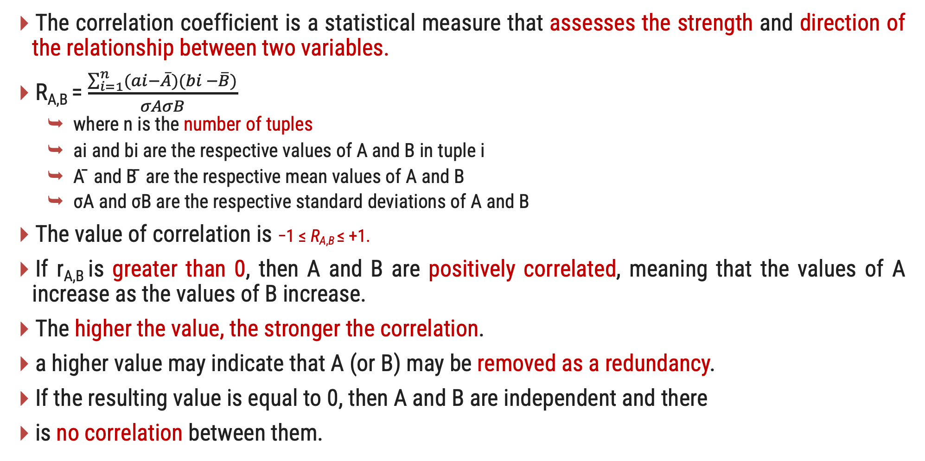
Correlation coefficient
Data Integration
The correlation coefficient is a statistical measure that assesses the strength and direction of the relationship between two variables.
R_{A,B} = $\frac{\sum_{i=1}^{n}{(ai−\overline{A})(bi −\overline{B})}}{σAσB}$
where n is the number of tuples
ai and bi are the respective values of A and B in tuple i
A ̄ and B ̄ are the respective mean values of A and B
σA and σB are the respective standard deviations of A and B
The value of correlation is −1 ≤ R_{A,B} ≤ +1.
If r_{A,B} is greater than 0, then A and B are positively correlated, meaning that the values of A increase as the values of B increase.
The higher the value, the stronger the correlation.
a higher value may indicate that A (or B) may be removed as a redundancy.
If the resulting value is equal to 0, then A and B are independent and there
is no correlation between them.

Slide 22
Correlation coefficient
Data Integration
If the resulting value is less than 0, then A and B are negatively correlated.
where the values of one attribute increase as the values of the other attribute decrease.
Scatter plots can also be used to view correlations between attributes
Positive Correlation :
Let's consider the relationship between the number of hours studied and the test scores obtained by a group of students.
Negative Correlation:
Suppose we examine the relationship between temperature and sales of ice cream.
No Correlation
Consider the relationship between shoe size and intelligence.

Slide 23
Data Transformation
Data Transformation
A function that maps the entire set of values of a given attribute to a new set of replacement values that each old value can be identified with one of the new values
Methods
Smoothing: Remove noise from data
Attribute/feature construction
New attributes constructed from the given ones
Aggregation: Summarization, data cube construction
Normalization: Scaled to fall within a smaller, specified range
Min-max normalization
Z-score normalization
Normalization by decimal scaling
Discretization: Concept hierarchy climbing

Slide 24
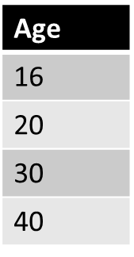
1. Min-Max Normalization
Data Transformation
Min max is a technique that helps to normalizing the data.
It will scale the data between 0 and 1 or within specified range.
Example
Formula : V’ $=\frac{v −MinA}{MaxA −MinA}{\left(NewMaxA −NewMinA\right)}^{}+NewMinA$
Given data
Min : Minimum value = 16
Max : Maximum value = 40
V = Respective value of attributes. In our example V₁= 16, V₂=20, V₃=30 & V₄=40.
NewMax = 1
NewMin = 0

Slide 25
1. Min-Max Normalization Cont..
Data Transformation
Example
Formula : V’ $=\frac{v −MinA}{MaxA −MinA}{\left(NewMaxA −NewMinA\right)}^{}+NewMinA$
For Age 16 :
MinMax (v’) = (16 – 16)/(40-16) * (1 – 0) + 0
= 0 / 24 * 1
= 0
For Age 30 :
MinMax (v’) = (30 – 16)/(40-16) * (1 – 0) + 0
= 14 / 24 * 1
= 0.58
For Age 20 :
MinMax (v’) = (20 – 16)/(40-16) * (1 – 0) + 0
= 4 / 24 * 1
= 0.16
For Age 40 :
MinMax (v’) = (40 – 16)/(40-16) * (1 – 0) + 0
= 24 / 24 * 1
= 1
Age | After Min-max normalization
16 | 0
20 | 0.16
30 | 0.58
40 | 1

Slide 26
2. Decimal Scaling
Data Transformation
In this technique we move the decimal point of values of the attribute.
This movement of decimal points totally depends on the maximum value among all values in the attribute.
Value V of attribute A can be normalized by the following formula
Normalized value of attribute
V’= V / 10^{j}
Example
CGPA | Formula | After Decimal Scaling
2 | 2 / 10 | 0.2
3 | 3 / 10 | 0.3
We will check maximum value among our attribute CGPA.
Maximum value is 3 so, we can convert it into decimal by dividing with 10. why 10?
We will count total digits in our maximum value and then put 1.
After 1 we can put zeros equal to the length of maximum value.
Here 3 is maximum value and total digits in this value is only 1 so, we will put one zero after 1.
Where j is the smallest integer such that Max(|ν’|) < 1

Slide 27


3. Z-Score Normalization
Data Transformation
It is also called zero-mean normalization.
The essence of this technique is the data transformation by the values conversation to a common scale where an average number equals zero and a standard deviation is one.
To find z-score values..
$$v′=\frac{v−μ_{A}}{σ_{A}}$$
Where μ: Mean, σ: Standard deviation
Example
Let μ = 54,000, σ = 16,000
Find z-score for 73,600,
$$\frac{73,600−54,000}{16,000}=1.225$$
Z-score for 73600: 1.225

Slide 28
3. Z-Score Normalization
Data Transformation
These z-scores represent the number of standard deviations that each data point is away from the mean of the distribution.
A positive z-score indicates that the data point is above the mean, while a negative z-score indicates it is below the mean.

Slide 29
Data Reduction
Data Reduction
Data reduction techniques can be applied to obtain a reduced representation of the data set that is much smaller in volume, yet closely maintains the integrity of the original data
That is, mining on the reduced data set should be more efficient yet produce the same (or almost the same) analytical results
Dimensionality reduction:
Dimensionality reduction techniques aim to reduce the number of variables or features in a dataset while preserving the important information.
Dimensionality reduction methods include wavelet transforms and principal components analysis.
Numerosity reduction:
Numerosity reduction techniques focus on reducing the number of instances or data points in a dataset while maintaining the representativeness of the data.
Data compression:
Data compression techniques are used to reduce the size of a dataset by encoding the data in a more compact form.

Slide 30
Data Reduction
Data Reduction
Original Data
Compressed
Data
lossless
lossy
Original Data
Approximated

Slide 31
Principal Components Analysis
Data Reduction
The number of input variables or features for a dataset is referred to as its dimensionality.
PCA transforms high-dimensional data into a lower-dimensional subspace while preserving the most important information.
Formally, PCA is a statistical technique for reducing the dimensionality of a dataset.
This is accomplished by linearly transforming the data into a new coordinate system where (most of) the variation in the data can be described with fewer dimensions than the initial data.
Dimensionality reduction refers to techniques that reduce the number of input variables in a dataset.
Example
Dimensional reduction can be discussed through a simple e-mail classification problem, where we need to classify whether the e-mail is spam or not.
This can involve a large number of features, such as whether or not the e-mail has a generic title, the content of the e-mail, whether the e-mail uses a template, etc.

Slide 32
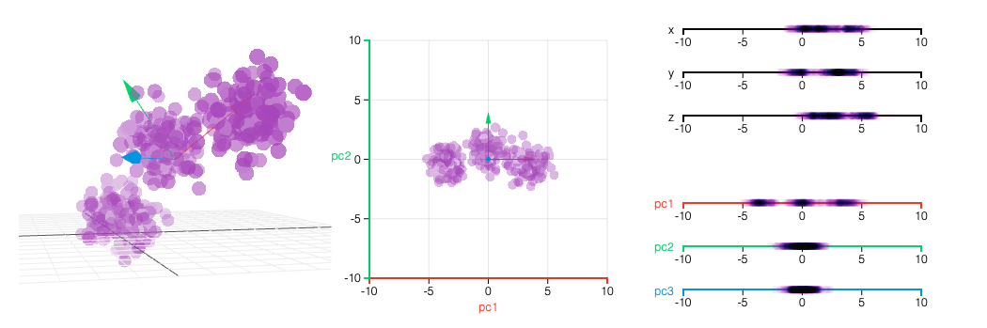
Principal Components Analysis
Data Reduction
Ref :” Principal Component Analysis, ” https://setosa.io/ev/principal-component-analysis/

Slide 33
Attribute Subset Selection
Data Reduction
Attribute subset selection is a technique used to reduce the dimensionality of a dataset by selecting a relevant subset of attributes (features) while discarding the irrelevant or redundant ones.
Redundant features and Irrelevant Features.
Example: Consider the below data for predication for 5th sem SPI of the given student.
Student Id | Name | Roll No | Sem Fee | Year fee | Sem 1 SPI | Sem 2 SPI | Sem 3 SPI | Sem 4 SPI
1 | ABC | 101 | 30,000 | 60,000 | 7.5 | 7.6 | 8.9 | 5.6
2 | XYZ | 102 | 30,000 | 60,000 | 4.5 | 6.7 | 4.3 | 6.7
Redundant features
Irrelevant Features

Slide 34
Attribute Subset Selection
Data Reduction
Here are the heuristic methods of attribute subset selection include the technique that follows.
Stepwise forward selection:
The procedure starts with an empty set of attributes. At each step. The best of the remaining original attributes is added to the set.
Stepwise backwards elimination:
The procedure starts with the full set of attributes. At each step. It removes the worst attribute remaining in the set.
Stepwise forward selection and stepwise backwards elimination:
At each step, the procedure selects the best attributes and remove the worst from among the remaining attributes.
Decision tree indication
It is generally used for classification.
It used flow type structure.
All the attributes not appearing in tree are assumed to be irrelevant.

Slide 35
Decision Tree Indication
Data Reduction
Initial attribute set
{A1, A2, A3, A4, A5, A6}
The Inner node represents an attribute.
An Edge represents a test on attribute.
Leaf represent one of the classes.
A4 ?
Y
N
A1 ?
A6 ?
Y
N
Y
N
Class 1
Class 2
Class 1
Class 2
Reduced attribute set
{A1, A4, A6}

Slide 36
Histograms
Data Reduction
A histogram is a useful visualization tool for data reduction as it provides a clear representation of the distribution of a dataset.
Histograms help in identifying patterns, outliers, and the general shape of the data, which can use full in making decisions about data reduction techniques.
A histogram for an attribute, A, partitions the data distribution of A into disjoint subsets, referred to as buckets or bins.
There are several partitioning rules, including the following:
Equal width (or distance) binning :
The simplest binning approach is to partition the range of the variable into k equal-width intervals.
The interval width is simply the range [Min, Max] of the variable divided by N,
Width = Max – Min / N (Number of Bins)
Equal depth (or frequency) binning :
In equal-frequency binning we divide the range [Max, Min] of the variable into intervals that contain (approximately) equal number of points; equal frequency may not be possible due to repeated values.

Slide 37
Clustering
Data Reduction
Cluster analysis or clustering is the task of grouping a set of objects in such a way that objects in the same group (called a cluster) are more similar (in some sense) to each other than to those in other groups (clusters).
Cluster analysis as such is not an automatic task, but an iterative process of knowledge discovery or interactive multi-objective optimization that involves trial and failure.
In data reduction, the cluster representations of the data are used to replace the actual data.
Cluster center
Outliers

Slide 38
Sampling
Data Reduction
Sampling is a data reduction technique that involves selecting a subset of data from a larger dataset to represent the whole data.
The objective of sampling is to reduce the size of the dataset while preserving its important characteristics and properties.
Simple random sample without replacement (SRSWOR):
Data is randomly selected from the original dataset, and once a data point is selected, it is not returned to the dataset before selecting the next data point.
No data point is selected more than once.
1
2
5
3
2
3
4

Slide 39
Sampling
Data Reduction
Simple random sample with replacement (SRSWR):
Data is randomly selected from the original dataset, and after each data point is selected, it is returned to the dataset before selecting the next data point.
it is possible for a data point to be selected more than once in the sample.
1
2
2
5
3
2
3
4

Slide 40
Sampling
Data Reduction
Cluster sample:
It converts the data into numbers of cluster and select cluster based on the SRSWOR technique.
Stratified sample:
A sampling method known as stratified sampling divides the population into subgroups or strata according to specific characteristics.
And taking a random sample from each stratum.
strata
4
1
2
3
4
5
4
2
3
4
2
1
2
1
2
3
4
5
5
2
1
3
4
1
SRS
3
5
1
2
3
4
5
4
3
2
5
2
5
3
1

Slide 41
Data Discretization
It transform continuous or numerical data into discrete intervals or categories.
It involves dividing the data values into bins or intervals, which can simplify data analysis and reduce the impact of noise.
Age
10
10-22
Young
22
23
41
50
23-70
Mature
60
70
90
100
71-100
Senior

Slide 42
Data Discretization
Discretization can make complex data more understandable and interpretable.
Some algorithms, especially those that require categorical data or work better with discrete values. we Discretization the data
In some cases, discretization can be used as a privacy-enhancing technique to prevent the disclosure of sensitive information.

Slide 43
Data Discretization Techniques
Discretization by Binning:
For example, attribute values can be discretized by applying equal-width or equal-frequency binning, and then replacing each bin value by the bin mean or median as in smoothing by bin means or smoothing by bin medians, respectively.
Discretization by Histogram Analysis:
A histogram is a useful visualization tool for data reduction as it provides a clear representation of the distribution of a dataset.
Discretization by Clustering:
Using clustering algorithms (e.g., k-means) to group similar data points into bins.
Discretization by Decision trees :
Using decision trees to find optimal split points for discretization.
Discretization by correlation :
When considering data discretization, correlation can help identify patterns and relationships between variables that might guide the creation of meaningful bins.

Slide 44
Concept Hierarchy
A concept hierarchy in data mining refers to the arrangement of data into a tree-like structure, with each level of the hierarchy representing a concept that is more general than the one below it.
This hierarchical data organization enables more efficient and effective data analysis, as well as the capacity to drill down to more specific levels of detail as necessary.
country
15 distinct values
state
365 distinct values
city
3567 distinct values
street
674,339 distinct values

Slide 45
Concept Hierarchy
Location
USA
India
New York
Illinois
Gujarat
UP
Utica
Albay
Joliet
Elgin
Surat
Rajkot
Lucknow
Noida

Slide 46
Questions
What is data Preprocessing ?
Explain data cleaning with example.
Explain different ways to fill missing values in dataset.
Explain binning method with example.
Explain how we can Identify outliers and smooth out noisy data ?
Explain data integration.
Explain data transformation with example.
Explain min max, decimal scaling and z score with example.
Explain data reduction with example.
Explain data sampling technique for data reduction.
What is data discretization ? Explain techniques for data discretization.
Explain concept Hierarchy.

